Slide 1
SIMULATION NOTEPAD
Submitted by
DEEPAN e
VIKRAM p

Slide 2
ABSTRACT
The Simulation Notepad is a software tool designed for creating and editing simulation models in various fields. It includes standard text editing features such as creating, opening, saving, undo, redo, cut, copy, paste, clear all, find, and replace, and a toolbar with formatting options like bold, italic, underline, font size, and font style. The tool also has a status bar that displays the number of lines, words, and letters in the current document, text-to-speech functionality, customizable themes, and a translation feature for English to Tamil. Additionally, users can access built-in applications like calculator, calendar, camera, and photos for efficiency in simulation modeling processes.

Slide 3
SYSTEM REQUIREMENT
HARDWARE REQUIREMENTS
Processor : Intel Core i3
Memory (RAM) : 4 GB
Hard Disk Space : 80 GB
Sound : Audio Device
Keyboard : Keyboard Device
Mouse : Pointing device
SOFTWARE SPECIFICATION
Operating System : Windows
Front-End : Python IDLE

Slide 4
SYSTEM STUDY
EXISTING SYSTEM
A normal notepad is a simple text editor application that is pre-installed on most Windows operating systems. It has a minimalist interface with a menu bar, and an editing area where users can type and edit text. The menu bar of the notepad includes options such as File, Edit, Format, View, and Help.
Under the File menu, users can create a new document, open an existing one, save or save as a file, and print the document. The Edit menu includes basic editing options such as Undo, Redo, Cut, Copy, Paste, Delete, and Select All. Users can also use keyboard shortcuts to perform these actions.
The View menu allows users to switch between Normal and Word Wrap views and adjust the zoom level. The Help menu provides users with help topics and information about the notepad.

Slide 5
PROPOSED SYSTEM
It includes standard features found in most text editors such as creating new files, opening existing files, saving, saving as, exiting, undo, redo, cut, copy, paste, clear all, find, and replace.
Additionally, it has a tool bar that includes various formatting options like bold, italic, underline, font size, and font style, to help users format their text.
The Simulation Notepad also includes text-to-speech functionality that allows users to have selected text or the entire text in the document read aloud
The Simulation Notepad also includes status bar that provides information on the number of lines, words, and letters in the current document, helping users keep track of their work.
In addition to these features, the Simulation Notepad also includes the ability to translate English to Tamil
The Simulation Notepad also includes various functionalities that make it easy to access Application software
The software also includes customizable themes, which provide users with a personalized look and feel.

Slide 6
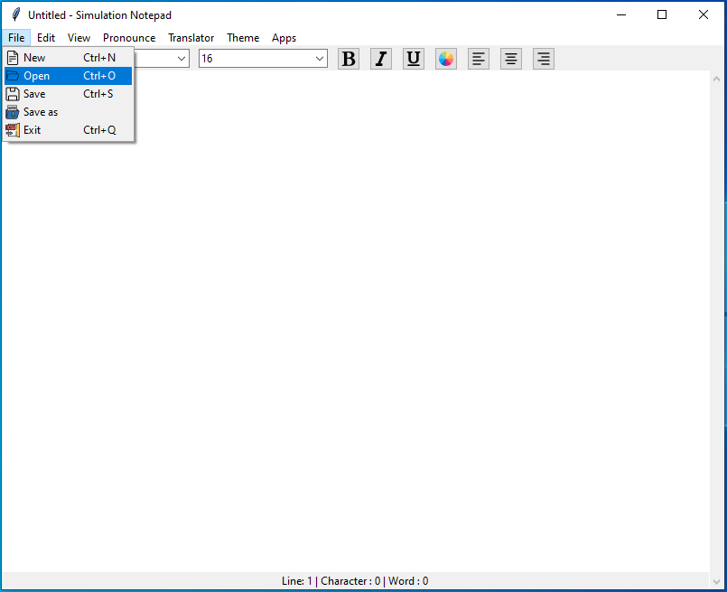
System Modules
File Module
The File module in the simulation notepad project is responsible for handling file-related operations, such as creating a new file, opening an existing file, saving the current file, saving the current file with a new name, and exiting.

Slide 7
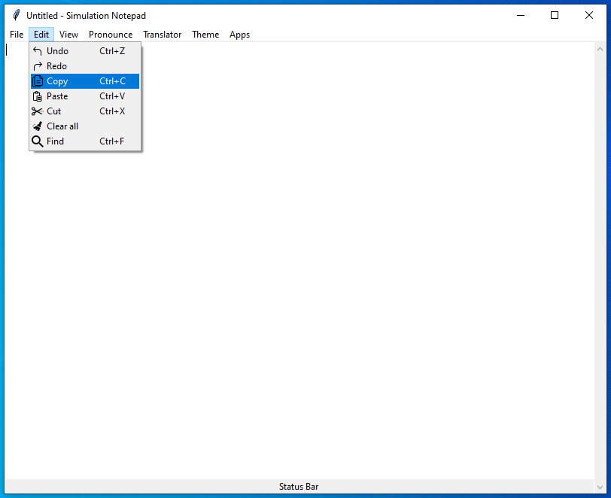
Edit Module
The Edit module in the Simulation Notepad project provides users with essential text editing functions. It includes features such as undo, redo, cut, copy, paste, clear all, find, and replace.

Slide 8
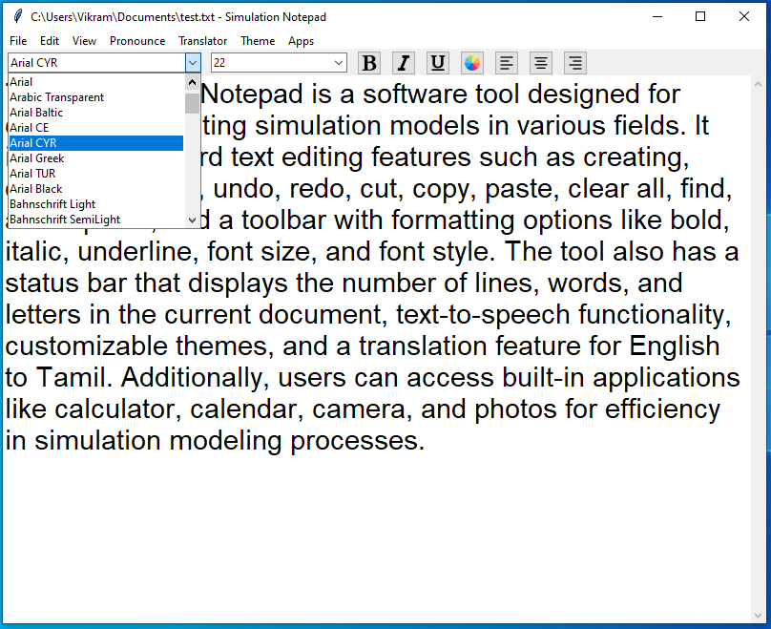
View Module
The View Module in your Simulation Notepad project includes a toolbar and a status bar.
In the toolbar, users can find options to format the text, such as bold, italic, underline, change font size, and change font style.
In the status bar shows the number of lines, words, and characters in the document.

Slide 9
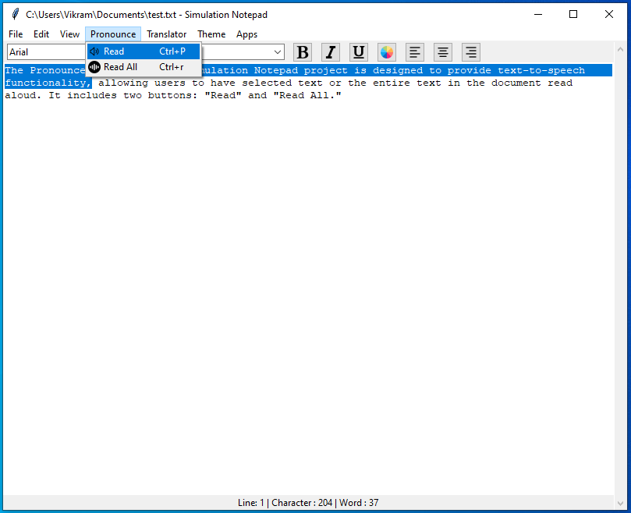
Pronounce module
The Pronounce module in your Simulation Notepad project is designed to provide text-to-speech functionality, allowing users to have selected text or the entire text in the document read aloud. It includes two buttons: "Read" and "Read All."

Slide 10
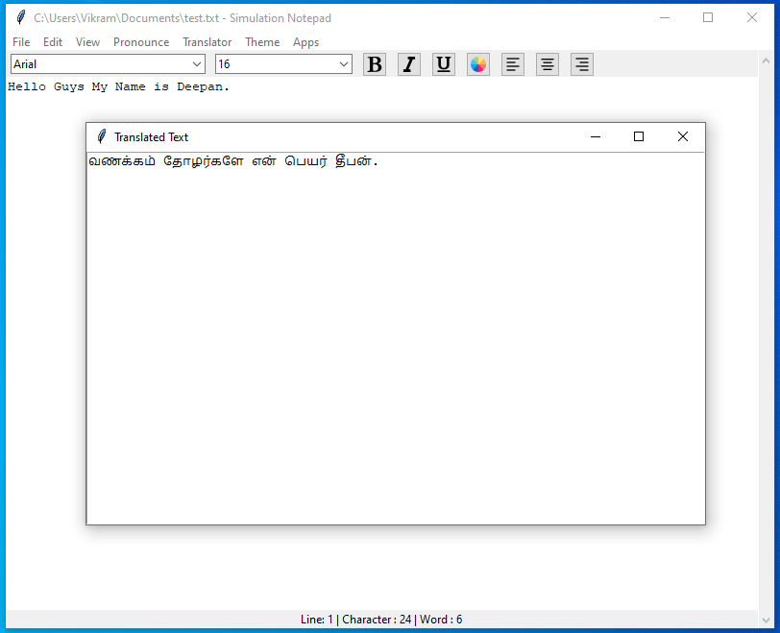
Transition Module
The Translation Module in the Simulation Notepad project provides users with the ability to translate English text to Tamil.

Slide 11
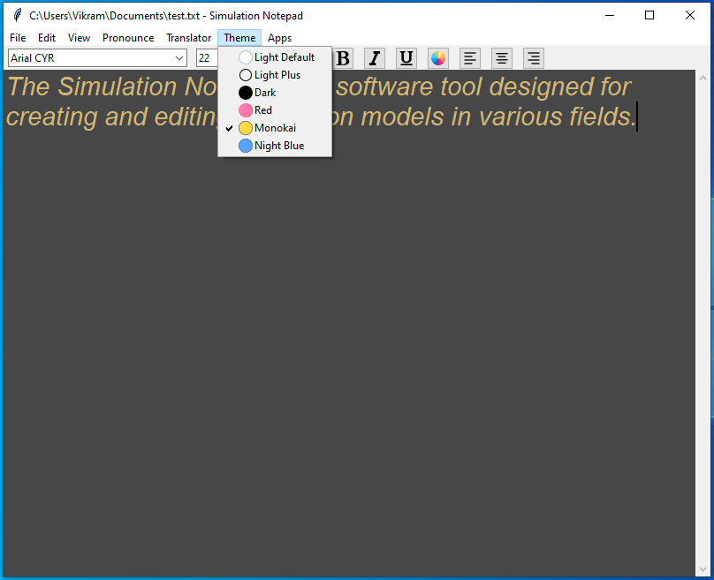
Theme Module
The Simulation Notepad project includes a Theme Module, which provides users with a choice of pre-defined themes to customize the look and feel of the application. The available themes are: Light Default, Light Plus, Dark, Red, Monokai, and Night Blue.

Slide 12
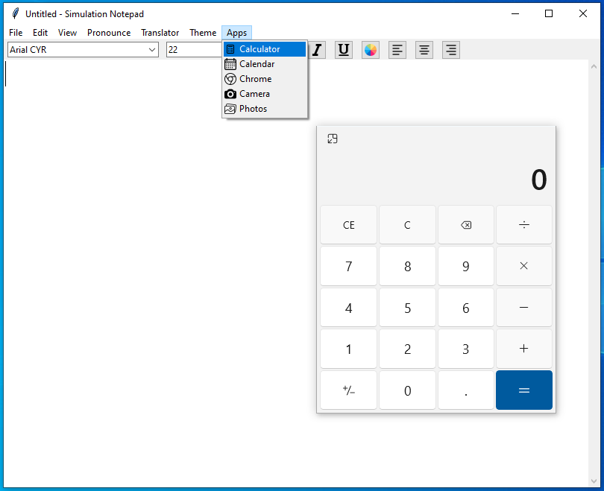
Apps Module
The Apps Module in your simulation notepad project provides quick and easy access to various system applications. This module allows users to open built-in applications like calculator, calendar, camera, and photos, among others, directly from within the software.

Slide 13
CONCLUSION
In conclusion, the Simulation Notepad is a versatile software tool designed for creating and editing simulation models in various fields. It includes essential text editing features, simulation modeling capabilities, quick access to system software, text-to-speech functionality, theme customization options, useful document statistics, and the added benefit of English to Tamil translation. The software is user-friendly and intuitive, making it accessible to users with varying levels of technical expertise.

Slide 14
Thank You

